Slide 1
Automatic Classification of purpose of software usages in scholarly articles
By: Bekalue Tadesse
20th April 2022

Slide 2
Overview
Introduction: software in research
Identification of Software Usage purposes
Annotation of Dataset
Classifier Models
Results
Conclusion

Slide 3
Introduction: software in a research
Software is pervasive in modern scientific research
Helps to understand research problem [24], document a research process, as well as provide evidence [29, 31]
Dictates quality of a research outcome [24, 19].
Based on surveys in the US (2017) and UK (2008), Scientists not only use software in their research but also create [26, 48].

Slide 4
Introduction: software in a research
Problems :
1. Poor software citation practice [52, 59]
Causes reproducibility problem
Deprives credits to developers of the software
2. Reliability of research results
scientists retracted their research paper [45, 46, 88]
Solution: Extraction detailed information about a software.

Slide 5
Introduction: software in a research
information about software
Explicit info.
Implicit info. (Hidden in text )
URL
Version
Release
Extension
Name of Developer … etc.
Type of mention
Creation, Usage, …etc.
Type of software
Application, OS, Plugin, ..etc.
Purpose of software Usage
Transparency
Reproducibility
Enhance software citation
Identify similar tools (by purpose) ➔Compare results obtained from similar tools ➔ test reliability of results
Semantic browsing of articles

Slide 6
Procedure for Automatic Extraction of software Usage purposes
Identify software usage purposes
Annotate SoMeSci Dataset with software usage purposes.
Pre-processing of Dataset
Analysis of Dataset
Classifier Model selection
Classification and Evaluation of performance

Slide 7
Identification of software usage purposes
Analysis of Literature – in the SoMeSci
Analysis of software Ontologies
The software Ontology (SWO)
OntoSoft
Wikidata
Analysis of Sci-Crunch

Slide 8
Identification of software usage purposes
Data Collection
Data Pre-Processing
Data Analysis
Data Visualization
Simulation
Stimulation
Modeling
Programming
Software purposes based on analysis of literature, software ontology(SWO), Ontosoft, WikiData, and Sci-Crunch

Slide 9
2. Annotation of Dataset with software purpose.
The Dataset
ANNOTATED with software purpose
SoMeSci article | Description
PLoS methods | 480 articles
PubMed full-text | 100 full-articles from PMC
PLoS sentences | 677 files that have software names mentioned in them
Creation sentences | 110 files that contain creation sentences (50 PMC, 60 PLoS)
Total | 1367 files
Annotation category | Types of annotations
Software-types (4) | Application, Plug-In, OS, PE
Mention-types (4) | Mention, Usage, Creation, Deposition
Additional-info (9) | Developer, Version, URL, Extension, Release, License, Abrv. & alt. name

Slide 10
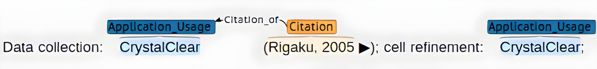
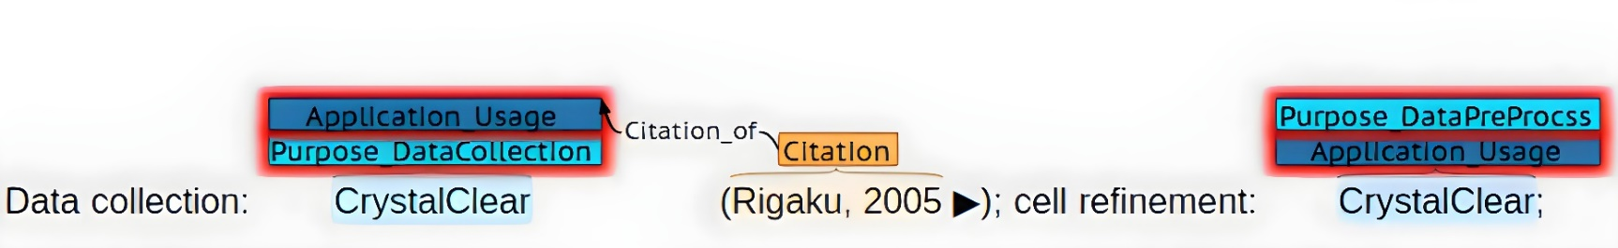
2. Annotation of Dataset with software purpose.
Annotation style: Top level annotation
e.g. 3D modeling, mathematical modeling ➔ annotated as modeling
Annotation Tool: BRAT

Slide 11
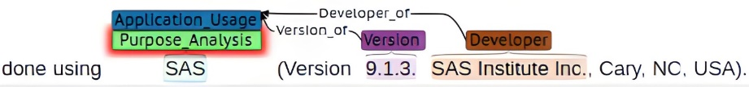
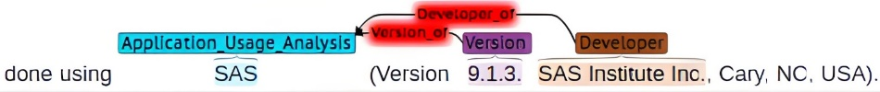
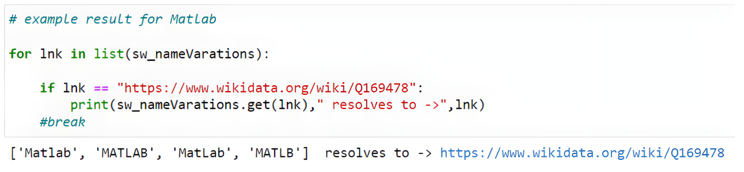
3. Pre-processing of Dataset
Automatic integrity testing
removing unintended annotations
adding missing annotations
Merging (Unifying) software purpose annotation with original (usage) annotation
co-reference resolution of software entities
Transformation to IOB format
Optimal Data splitting Train-Dev-Test (60-20-20), with ±5% for each class label

Slide 12
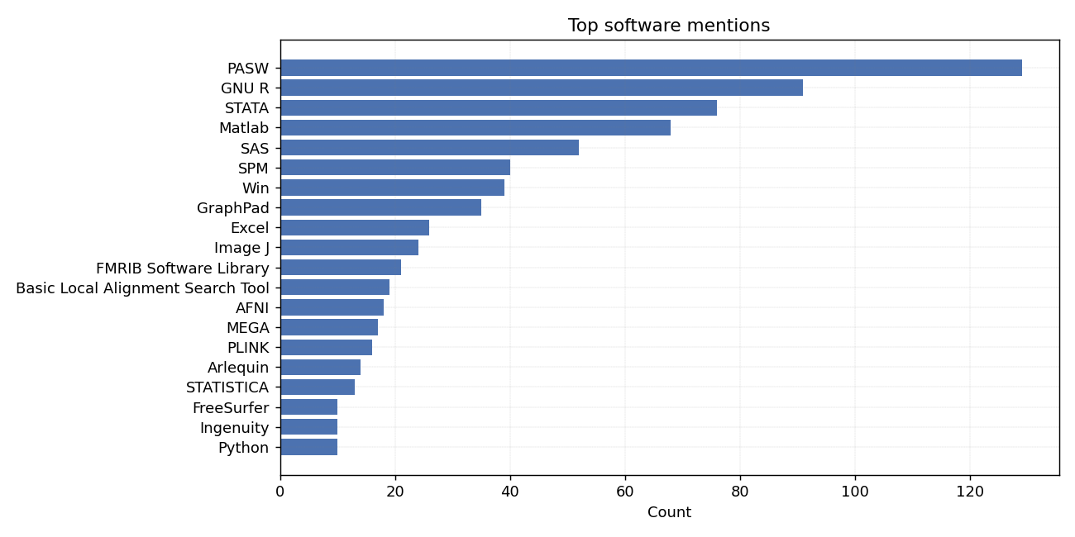
4. Analysis of Dataset

Slide 13
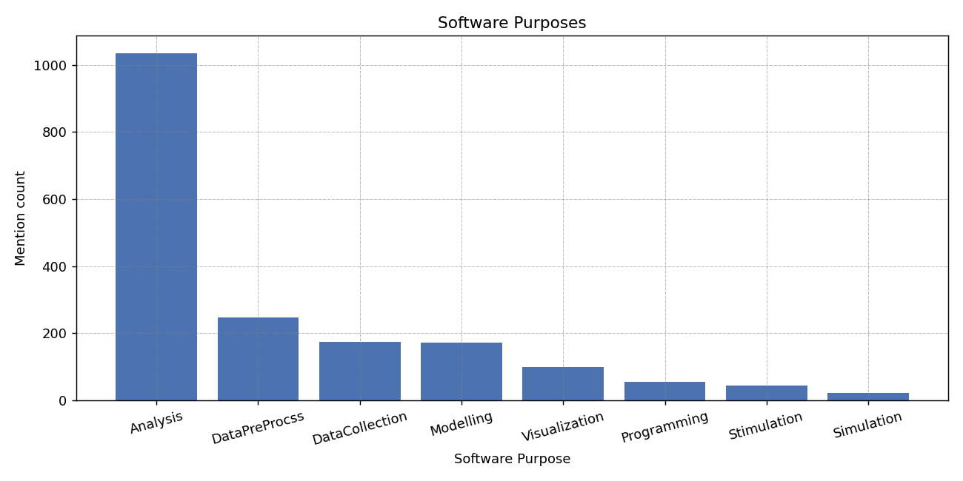
4. Analysis of Dataset

Slide 14
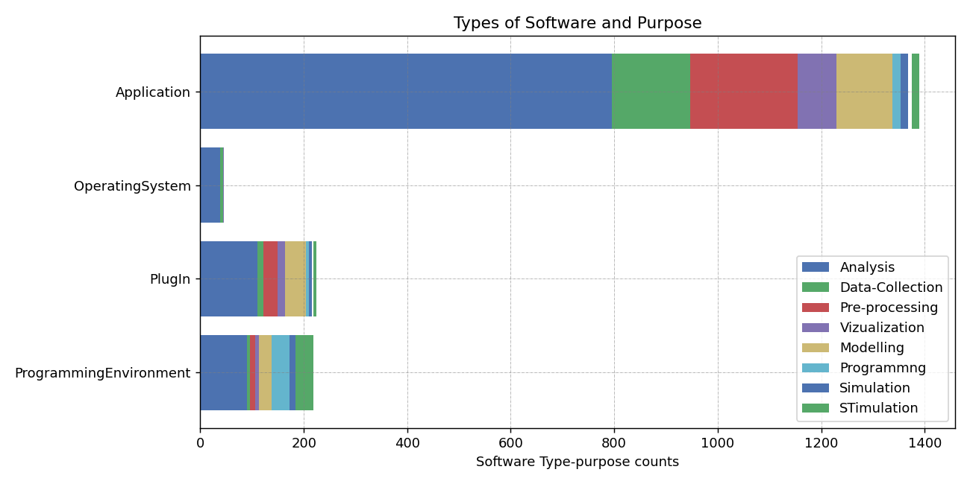
4. Analysis of Dataset

Slide 15
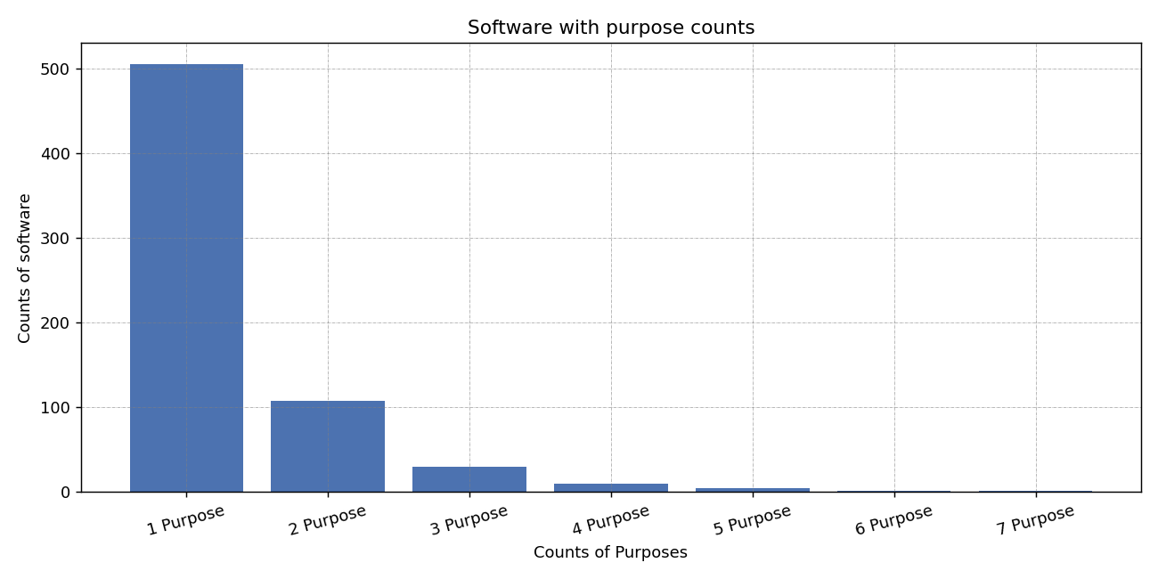
4. Analysis of Dataset

Slide 16
5. Classifier Model Selection
Software is a real-world entity ➔ classification of software purposes == NER task
NER is one of classical Sequence labeling tasks among POS & Chunking
Two classes of sequence labeling models:
Classical ML Models
DL Models (State-of-the-art)
HMM
MEMM
CRF
RNN architecture
LSTM
Bi-LSTM
Bi-LSTM-CRF
Transformer architecture
BERT
Bio-BERT
Sci-BERT

Slide 17
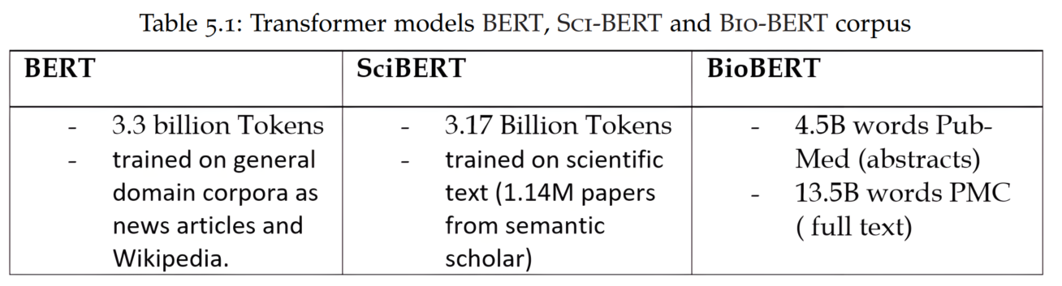
5. Classifier Model Selection
RNN architectures
Transformer architectures (BERT)
Plain RNNs fail to capture context (long range dependencies ) due to vanishing and exploding gradient problems
LSTM variants of RNN is capable of capturing context in one direction
Bi-LSTM-CRF captures context in both-directions + understands correlations among adjacent features
Bi-LSTMs are slow to train
(No parallelization capability)
Require a lot of training data
No transfer learning capability
State-of-the-art
Pre-trained with unlabeled data
fine tune for downstream applications
Captures context in both direction at once!
Faster
Able to parallelize using GPUs
Transfer learning capability
Verities:
Bio-BERT
Sci-BERT
Used for software purpose classification

Slide 18
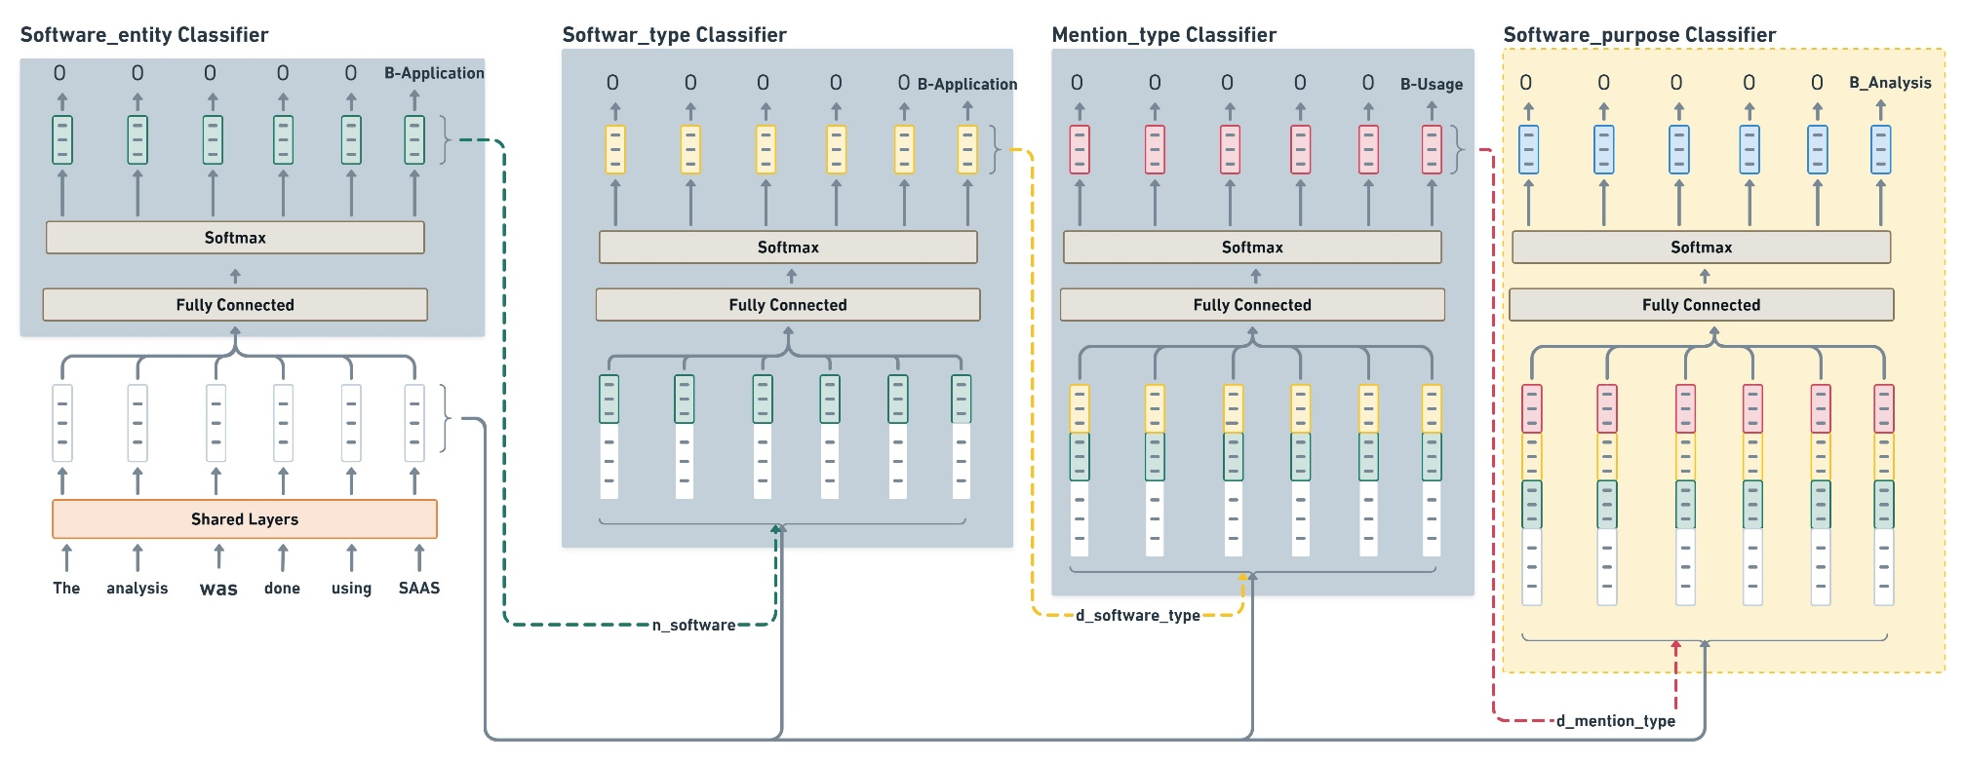
5. Classifier Model Selection
BERT Model
Part of SoMeSci-Project
Extension

Slide 19
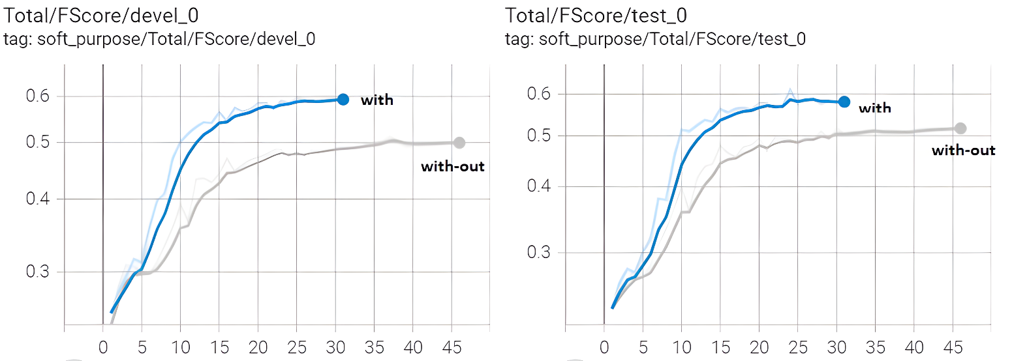
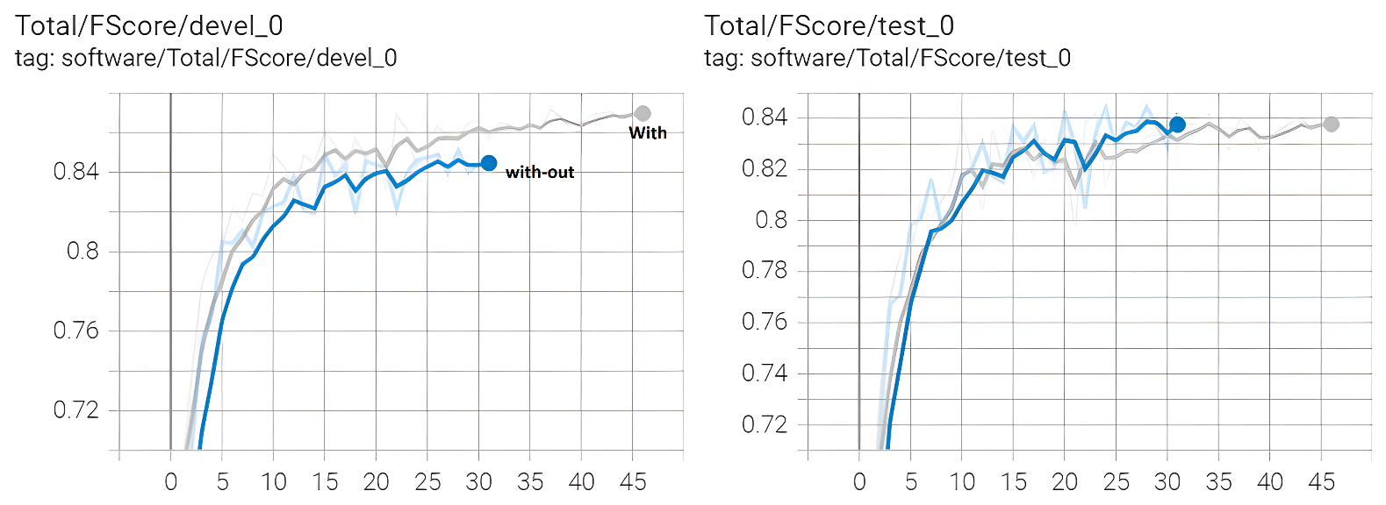
6. Software purpose classification Results
The impact of labeled data

Slide 20
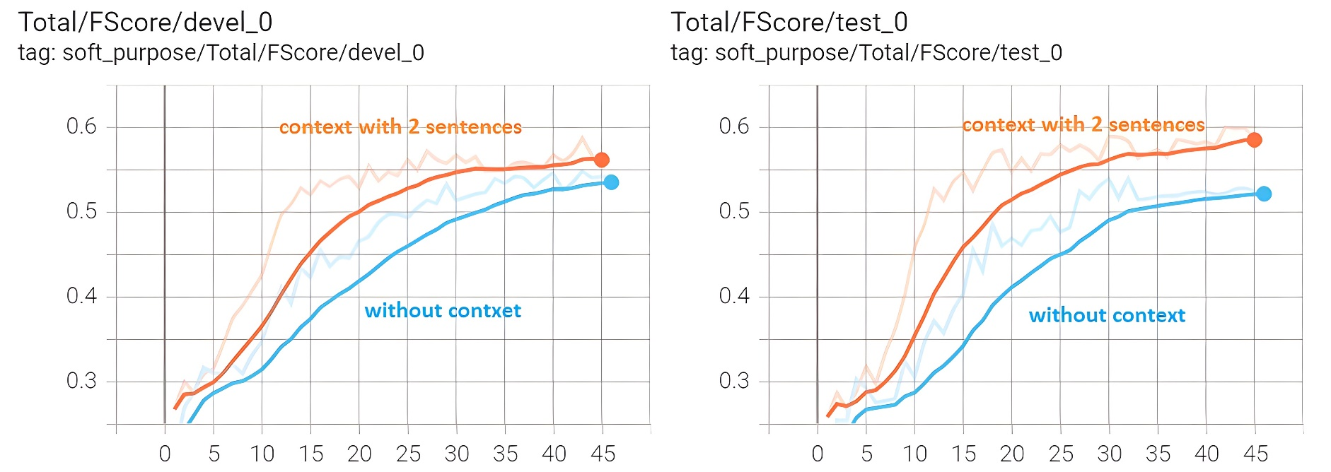
6. Software purpose classification Results
The impact of larger context

Slide 21
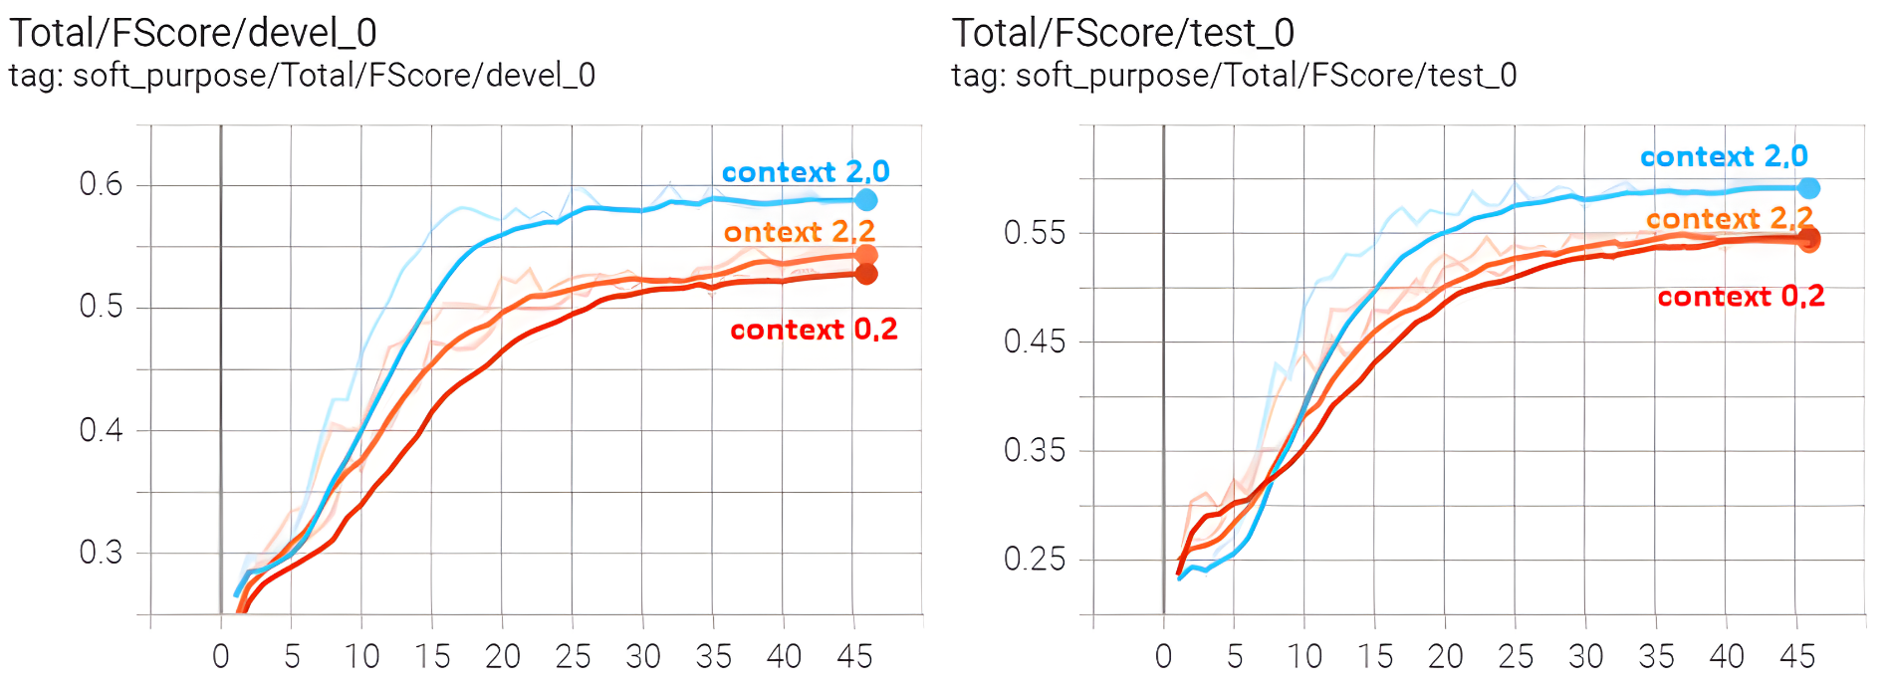
6. Software purpose classification Results
Left-vs-Right Context

Slide 22
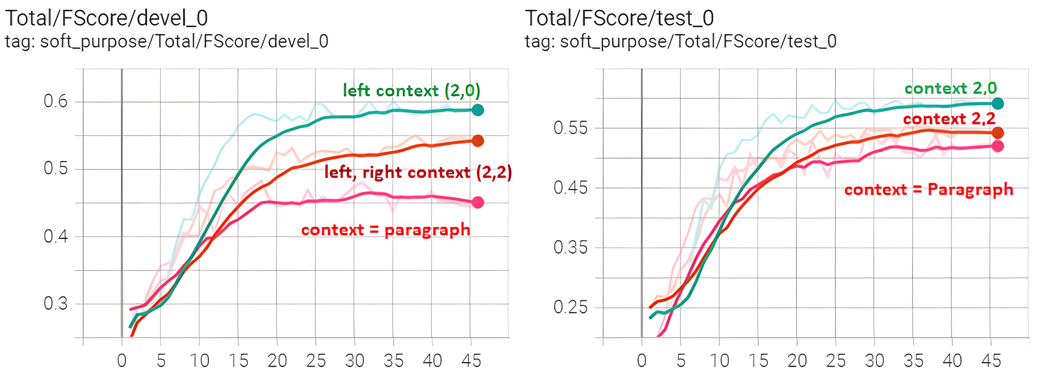
6. Software purpose classification Results
Context == whole paragraph

Slide 23
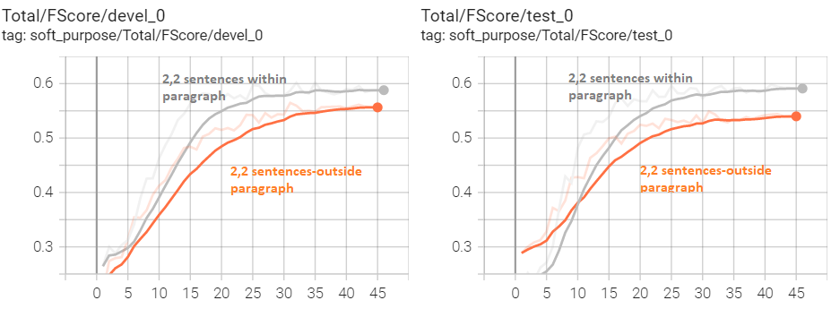
6. Software purpose classification Results
Context == outside paragraph

Slide 24
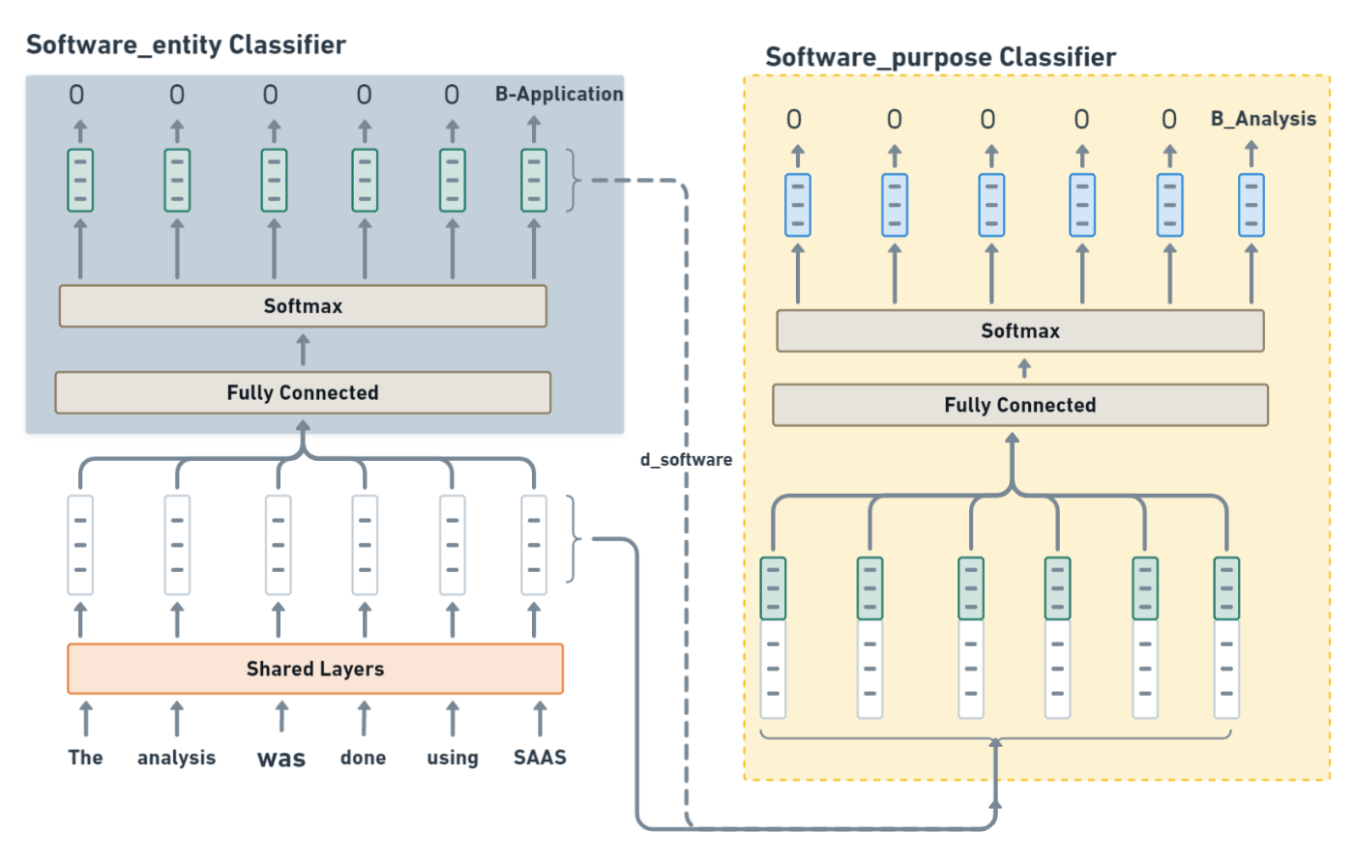
6. Software purpose classification Results
Classification with 2-Cascade Sci-BERT

Slide 25
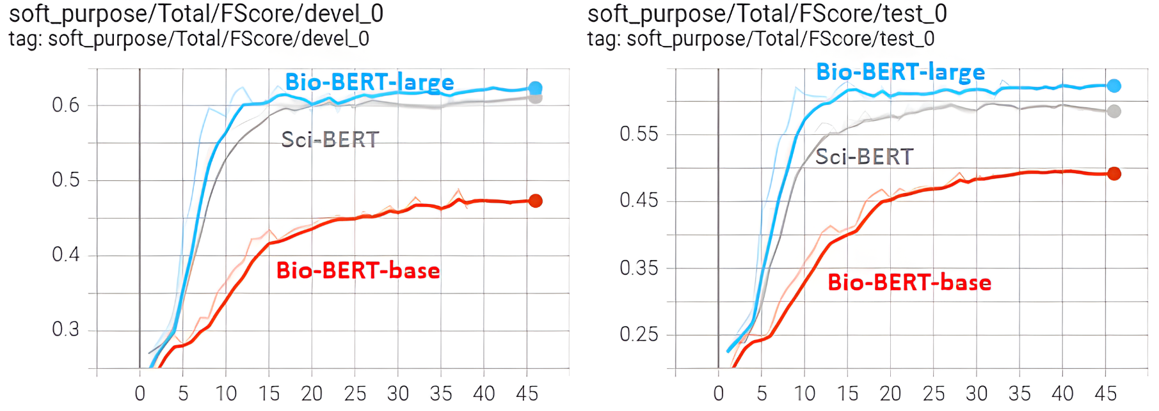
6. Software purpose classification Results
Bio-BERT vs Sci-BERT

Slide 26
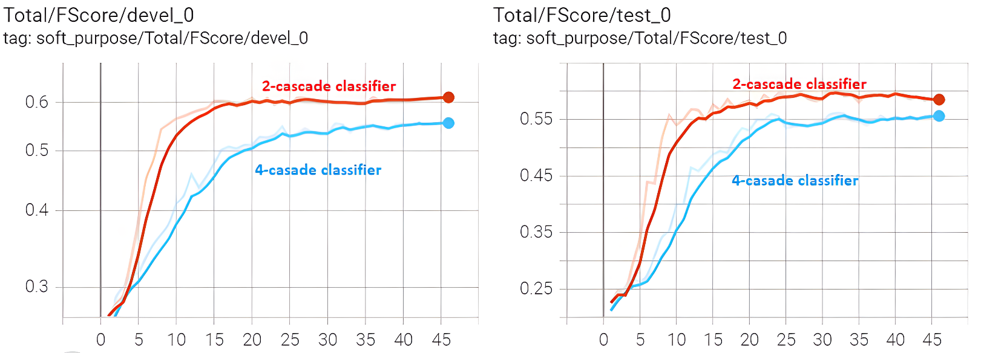
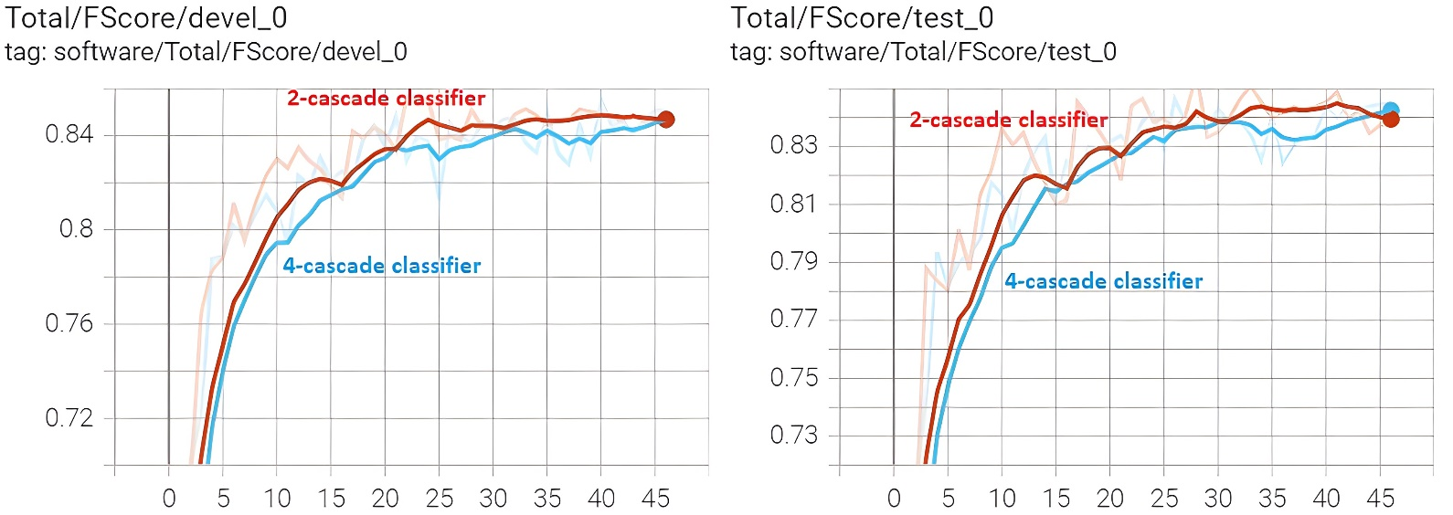
6. Software purpose classification Results
Classification with 2-Cascade Sci-BERT

Slide 27
7. Conclusion
The role of software in scientific investigation is paramount.
Automatic classification of software usage purposes has been successful with a minimal set of annotated data set.
Various level of context affects classification performance. Two sentences from the left gives slightly better classification performance.
Unbounded context such as context as a whole paragraph or context outside a paragraph did not improve classification performance.
Classification with other variants of BERT model such as Bio-BERT-large gives a slightly better performance compared to Sci-BERT model, however it is slower.
Software purpose classification performance is greater for software purposes with larger number of class labels.

Slide 28
7. Future work
To increase classification performance, the remaining part of SoMeSci dataset can be annotated further and SoMeSci corpus size could also be increased.
Annotation of software usage purposes can also be done by domain experts.
Software tools that have similar purpose can be identified to cross-validate and compare results from various software tools.
Semantic browsing of scientific-articles can also be implemented based on a use of similar software for similar purpose.

Slide 29
Discussion

Slide 30
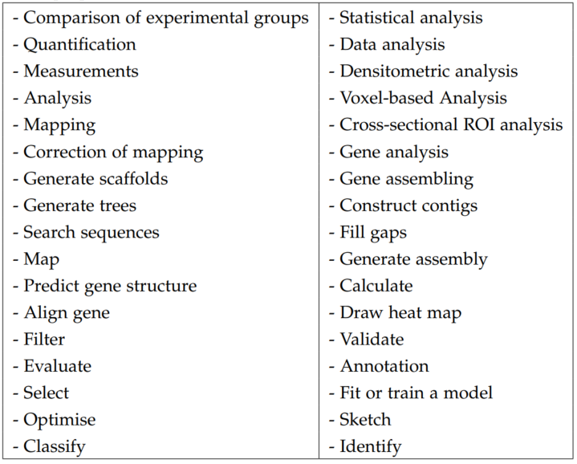
Identification of software usage purposes
Key words
(from the literature)
that reflect potential software usage purposes.
Intractable to manually analyze the whole SoMeSci Corpus.
Literature

Slide 31
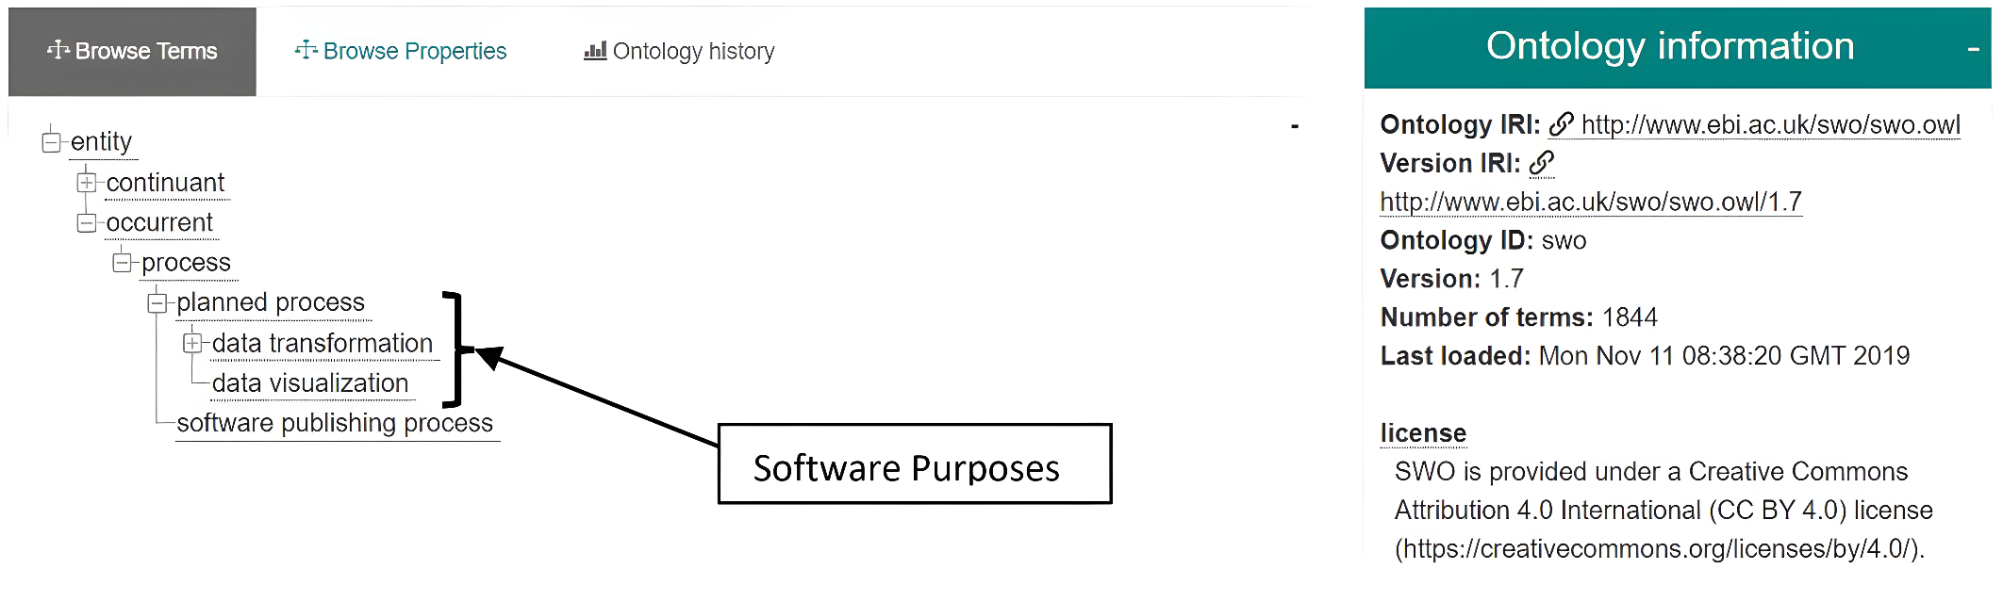
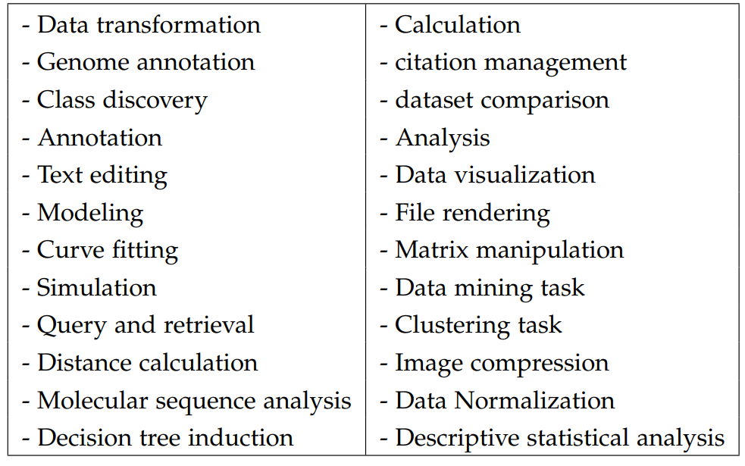
Identification of software usage purposes
The software ontology (SWO) – description of software for computational biology and informatics
SWO
(retrieval date 13-12-2021)

Slide 32
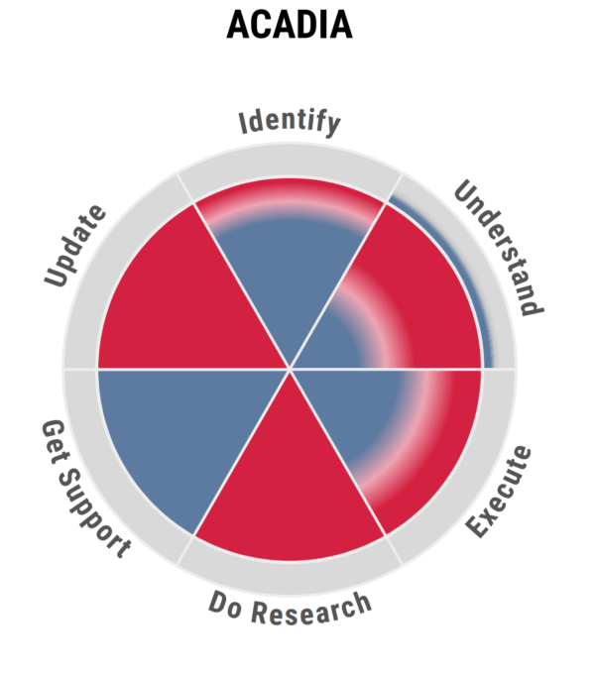
Identification of software usage purposes
Ontosoft– description of software for geo-science
Descriptions are 6-dimensional and in a pie-chart
Dimension | information
Identify | - Name of software, abbreviation
Understand | - Domain specific key words (~400)
Execute | - System requirements, license
Do Research | - Preferred citation
Get Support | - Contact details
Update | - version, maintenance, etc.

Slide 33
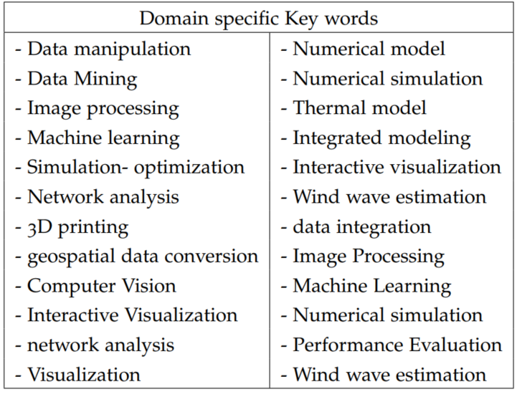
Identification of software usage purposes
OntoSoft
(retrieval date 13-12-2021)

Slide 34
Identification of software usage purposes
WikiData
a multi-lingual knowledge graph curated by Wikimedia community
no information about software purposes (as of today)
Available information is about software category
460 different software categories

Slide 35
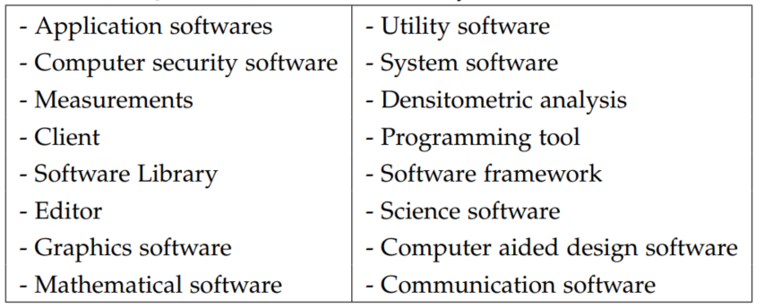
Identification of software usage purposes
WikiData

Slide 36
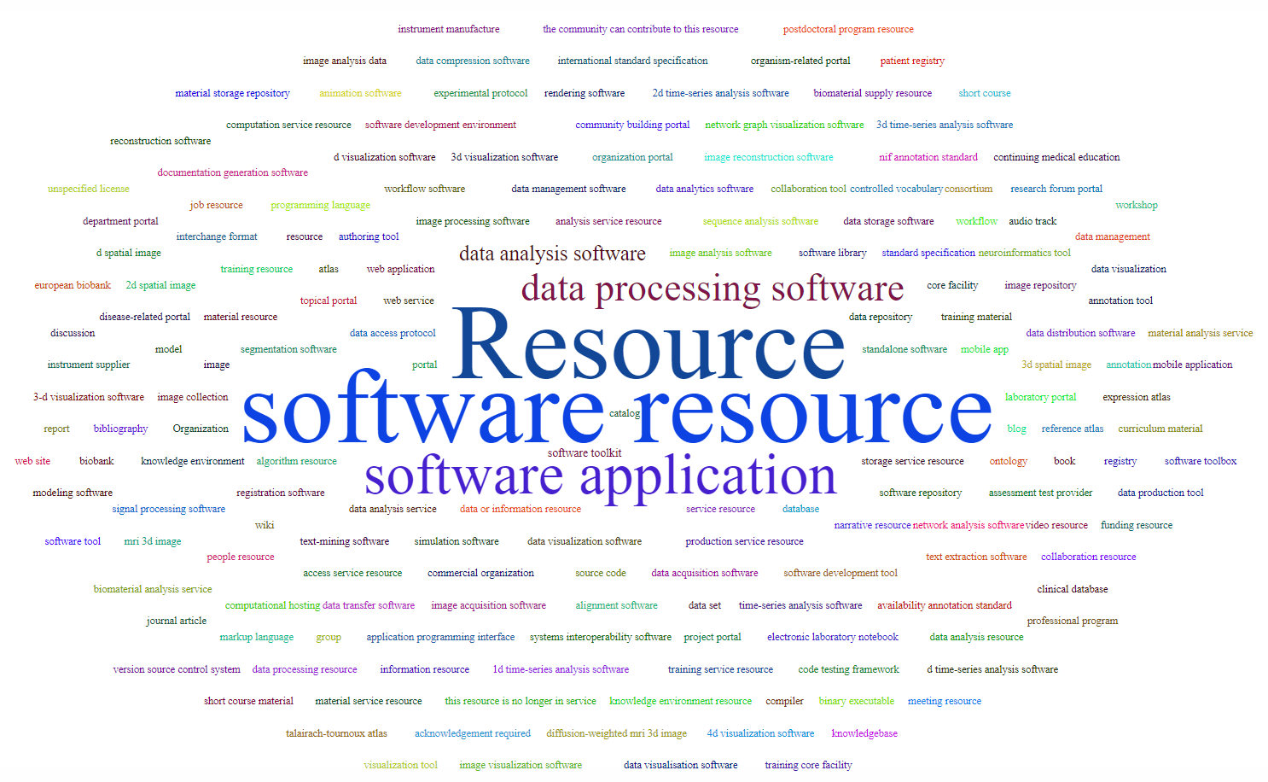
Identification of software usage purposes
Sci-Crunch Registry– 200 types of software tools

Slide 37
Introduction: Extraction approaches
Manual approach
Not scalable
Rule based Approaches
Capture only well defined / explicit information about software
Fail to extract information hidden in the textual description
3. Automatic approach using Machine/Deep Learning
DL approach is applied recently [60]
Scalable and able to extract information hidden in the text

Slide 38
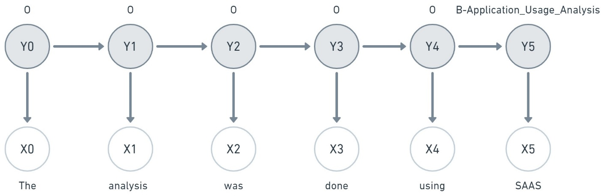
5. Classifier Model Selection
Hidden Markov Model
Sequence of hidden states (Yi)
Are based on Markov chain
Infers X based on Y, Generative model
Transition in the hidden states of Y generates observations X based on joint probability P(Y,X)
HMMS fail to capture long rage dependencies, consider only prior state

Slide 39
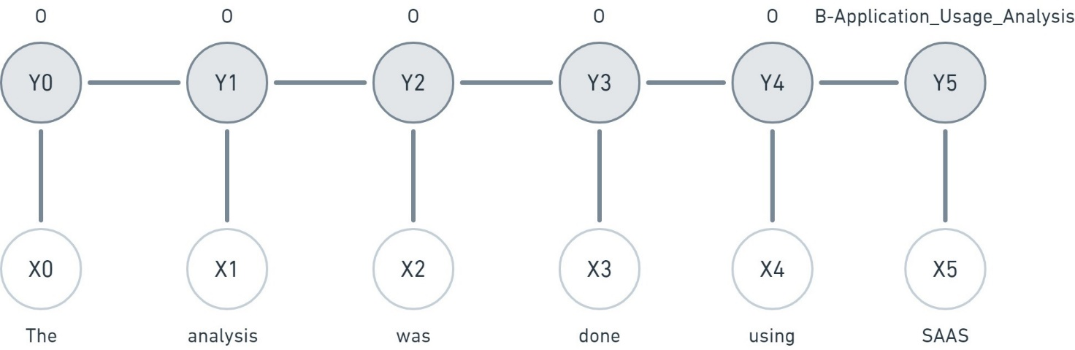
5. Classifier Model Selection
(Linear) Conditional Random Field
Are based on conditional probability P(Y|X) unlike joint probability P(Y,X) of HMMs
Discriminative model, infers Y from X
Captures long range dependencies
Inference of Y is based on all past and future states ➔ computationally expensive

Slide 40
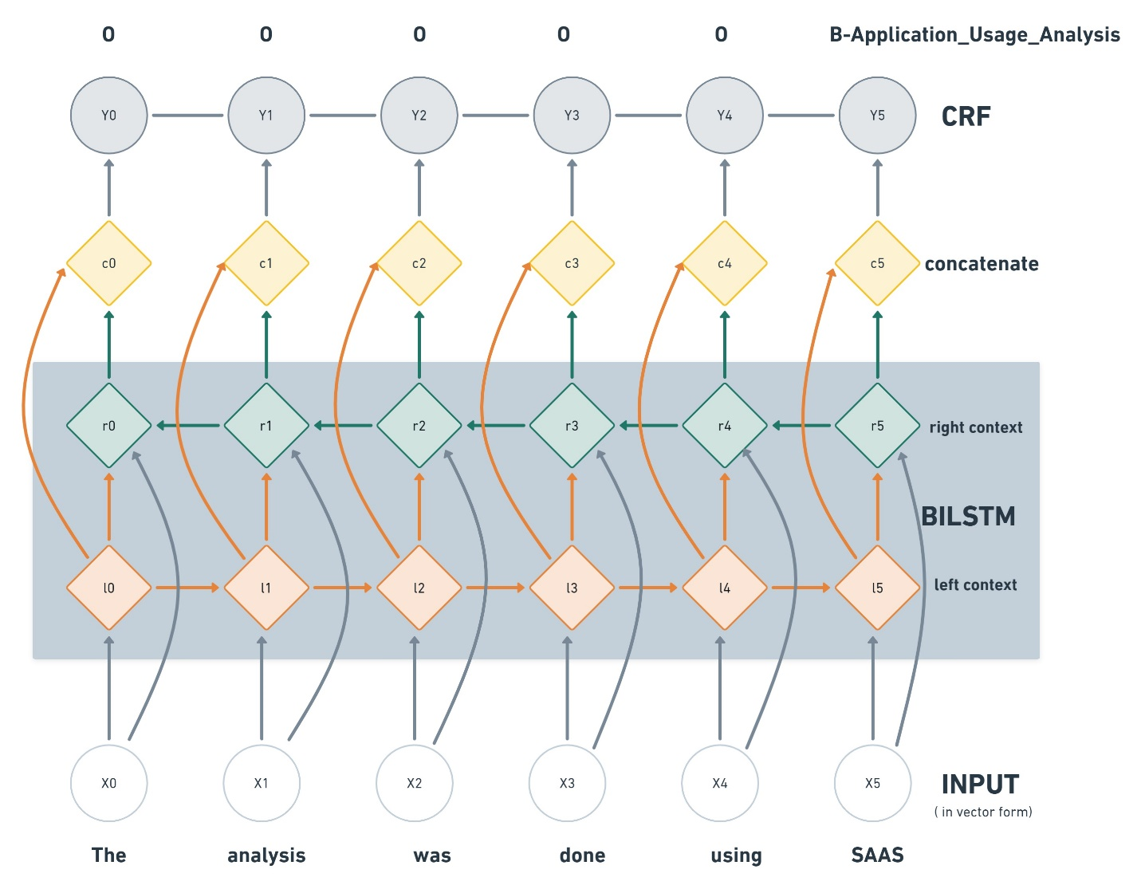
5. Classifier Model Selection
Bi-LSTM-CRF

Slide 41
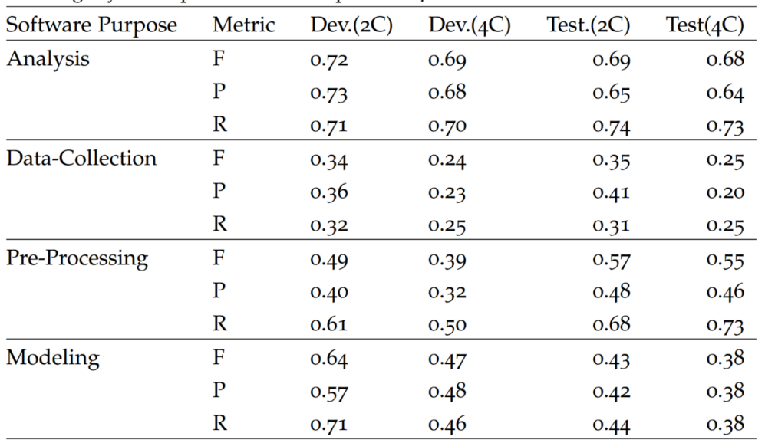
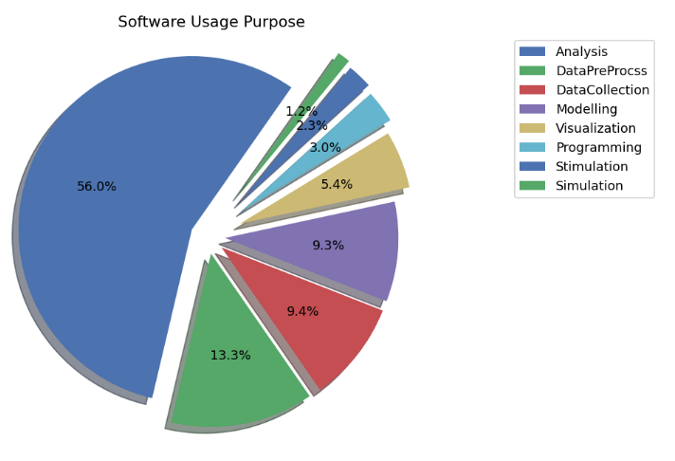
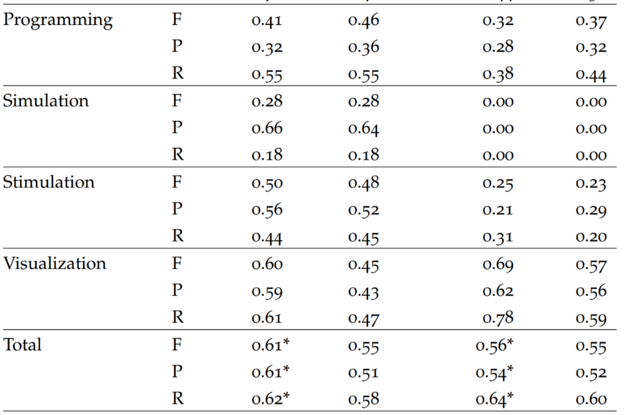
6. Software purpose classification Results
Summary of classification performance 2C-Sci-BERT-Model

